Slide 1
IST687 Project Update #3
Agile Kanban Methodology
ADS Group 4
Jacob Dineen
Mason David
Mohamed Khalifa
Zhaowei Jiang
Kellie Mosely

Slide 2
Kanban Board
BACKLOG | IN-PROGRESS | ANALYSIS | DEPLOYED
None | Final Presentation Final Analysis Final Interpretation Final Visualizations | SVM KSVM Naïve Bayes Association Rules NPS Linear Modeling Summary Statistics Findings | Data Cleansing Data Transformation Data Architecture Preliminary Data Analysis

Slide 3
Team Page
Trello Link
Main Board:
https://trello.com/b/lXdbFrjQ/
Update 2 Board:
https://trello.com/b/zeJP8P5Q/update-3

Slide 4
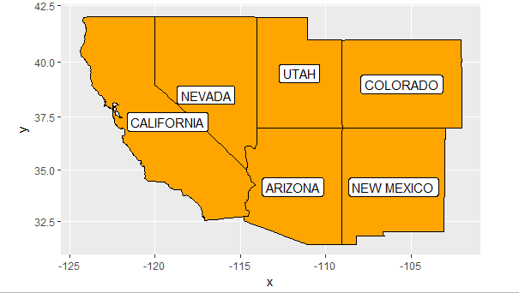
What’s the scope
file-> out-201501rv
Area of focus
Demographic/ Behavior
Amenities
Hotel/Brand Classification
Geographical Scope = California, Arizona, Nevada, Utah, Colorado, New Mexico

Slide 5
Business Question
What’s our target region?
Is there a relationship between audience demographics/behavior and NPS?
What specific criteria “amenities” contribute to higher NPS?
What recommendations can we provide to our clients to maximize the overall NPS?

Slide 6
Overall Summary
Accomplishments this past period
Summary Statistics on Dataset
Expanded scope of project
Answered Business Questions
Calculated NPS Score
Built Models – Linear, SVM, KSVM, Naïve Bayes, Association Rules
What is working well
Active Participation
Communication
Team Bonding
Brainstorming
Organization
Plans for next update
Create PowerPoint Presentation with findings presented in a way that is understandable to someone who isn’t data savvy.
Prepare Final Word Document with findings/analysis inclusive of R code to be sent to data science team leader.
Recommendation for client.
Issues / What is not working well
Fine tuning models.
Data Understanding | Preprocessing | Analysis | Testing | Communicating Results
 |  | 40% of time / 5 people | 40% of time / 5 people | 20% of time / 5 people

Slide 7
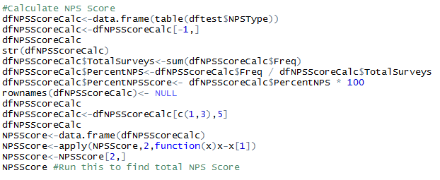
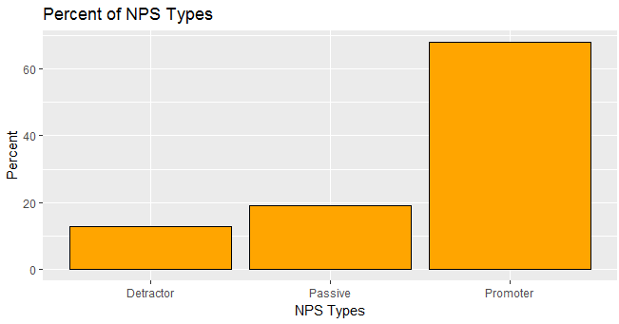
NPS Score

Slide 8
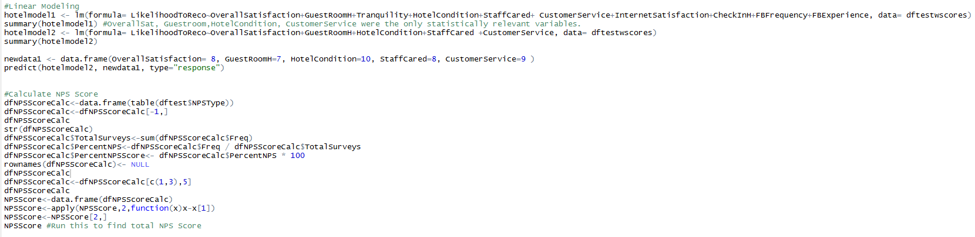
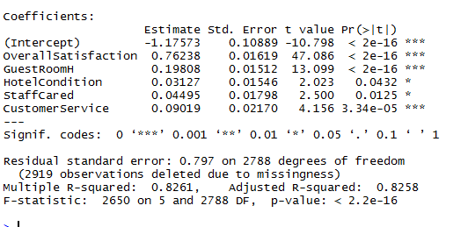

Linear Modeling

Slide 9
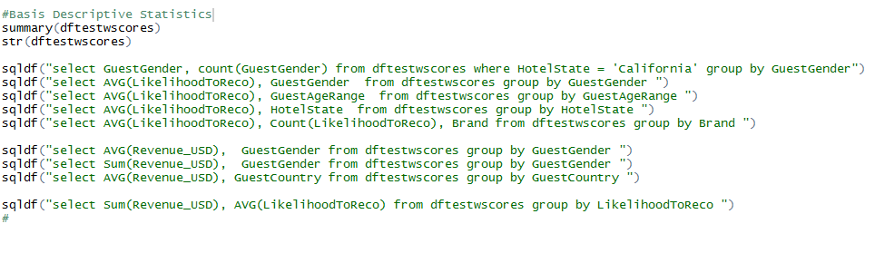
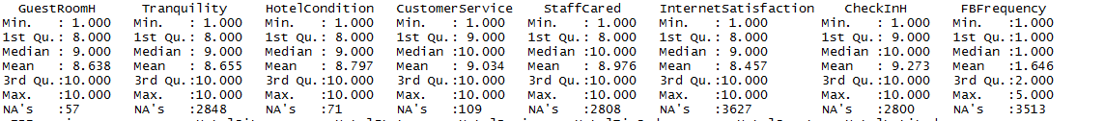
Descriptive Statistics

Slide 10
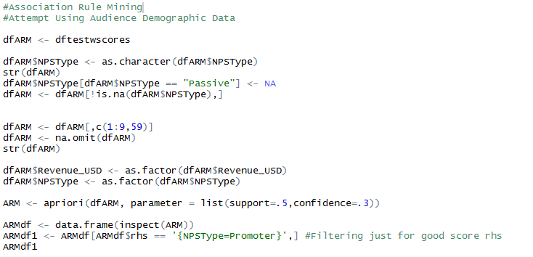
Association Rule Mining

Slide 11
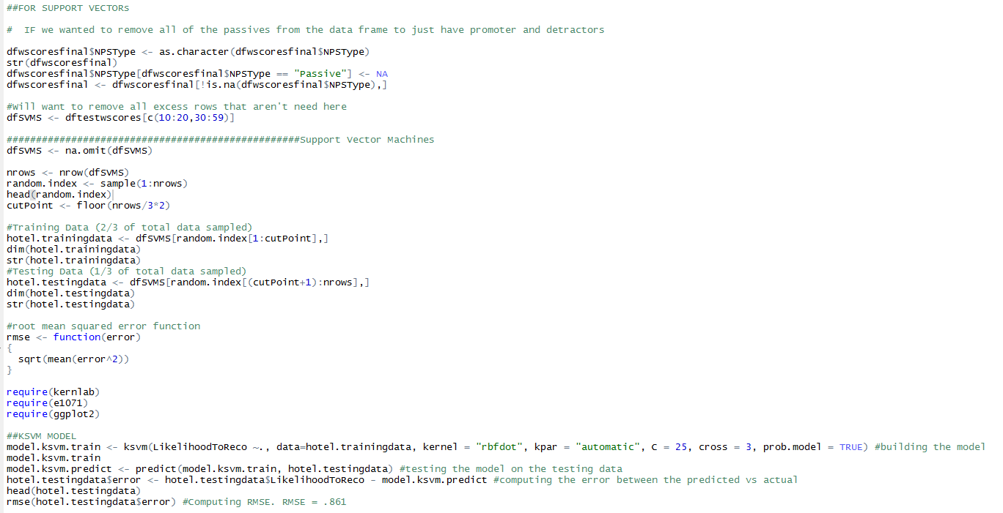
SVMs

Slide 12
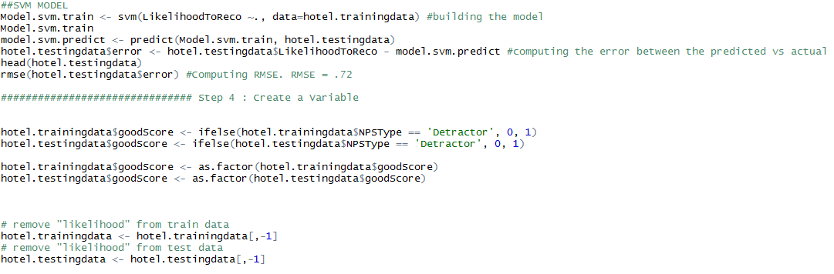
SVMs Continued

Slide 13
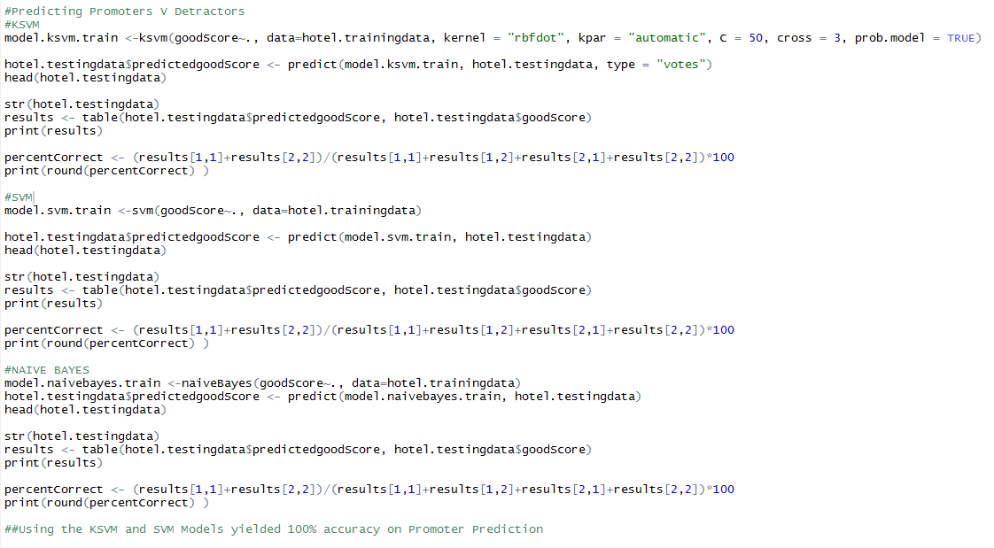
SVMs Continued

